Slide 1
Intro to Programming
Class 2: Let’s get moving!
November 2021
Emily Gelfand
Emily Joyce

Slide 2

Disclaimer
I will be running through the basics, and potentially skipping some depending on time. This is meant to be an intro/overview, so absorb what you can now and go back over this later on your own time if you think you need to nail it down further. Don’t worry if it feels like a lot – it is!

Slide 3
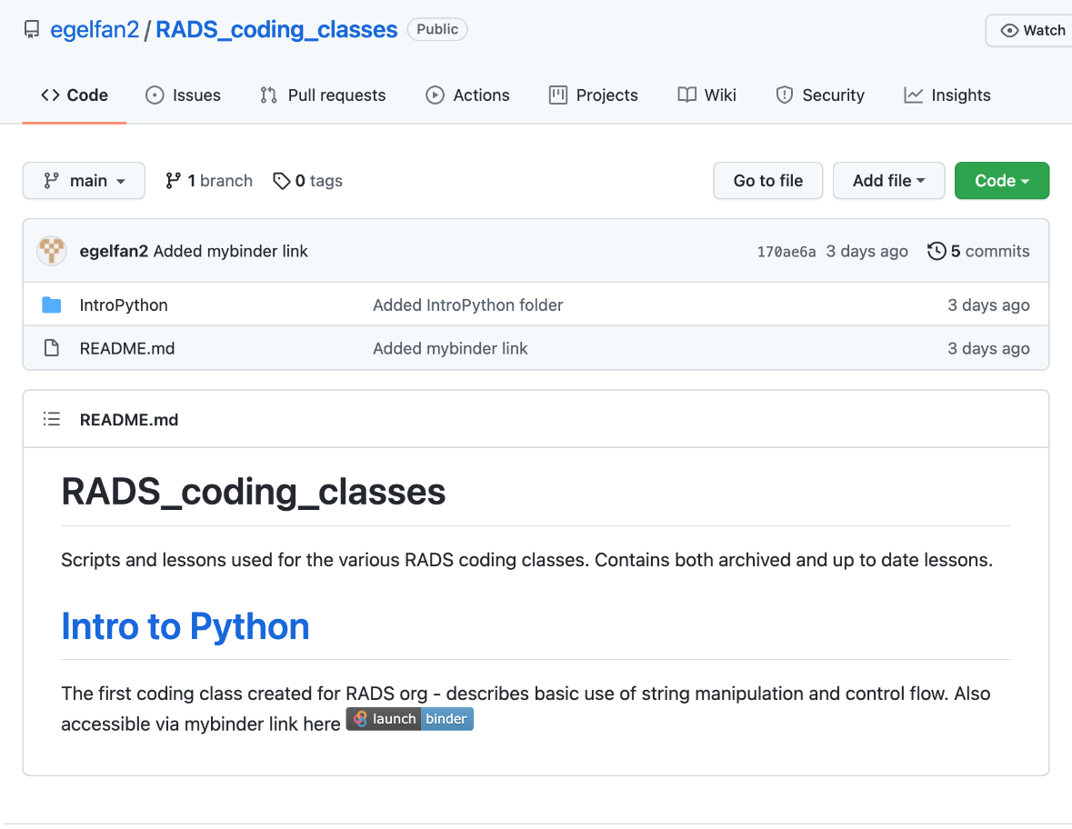
Getting started
We are going to skip installing python for this class and instead practice coding in our browsers.
Go to https://github.com/egelfan2/RADS_coding_classes in your browser
Click on launch | binder

Slide 4
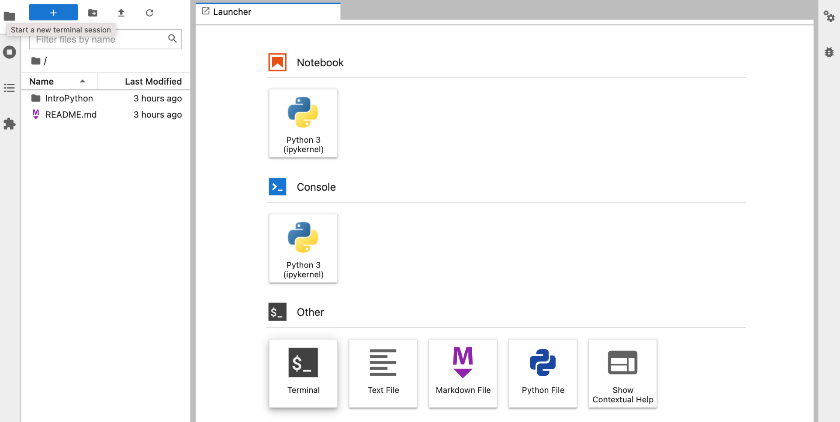
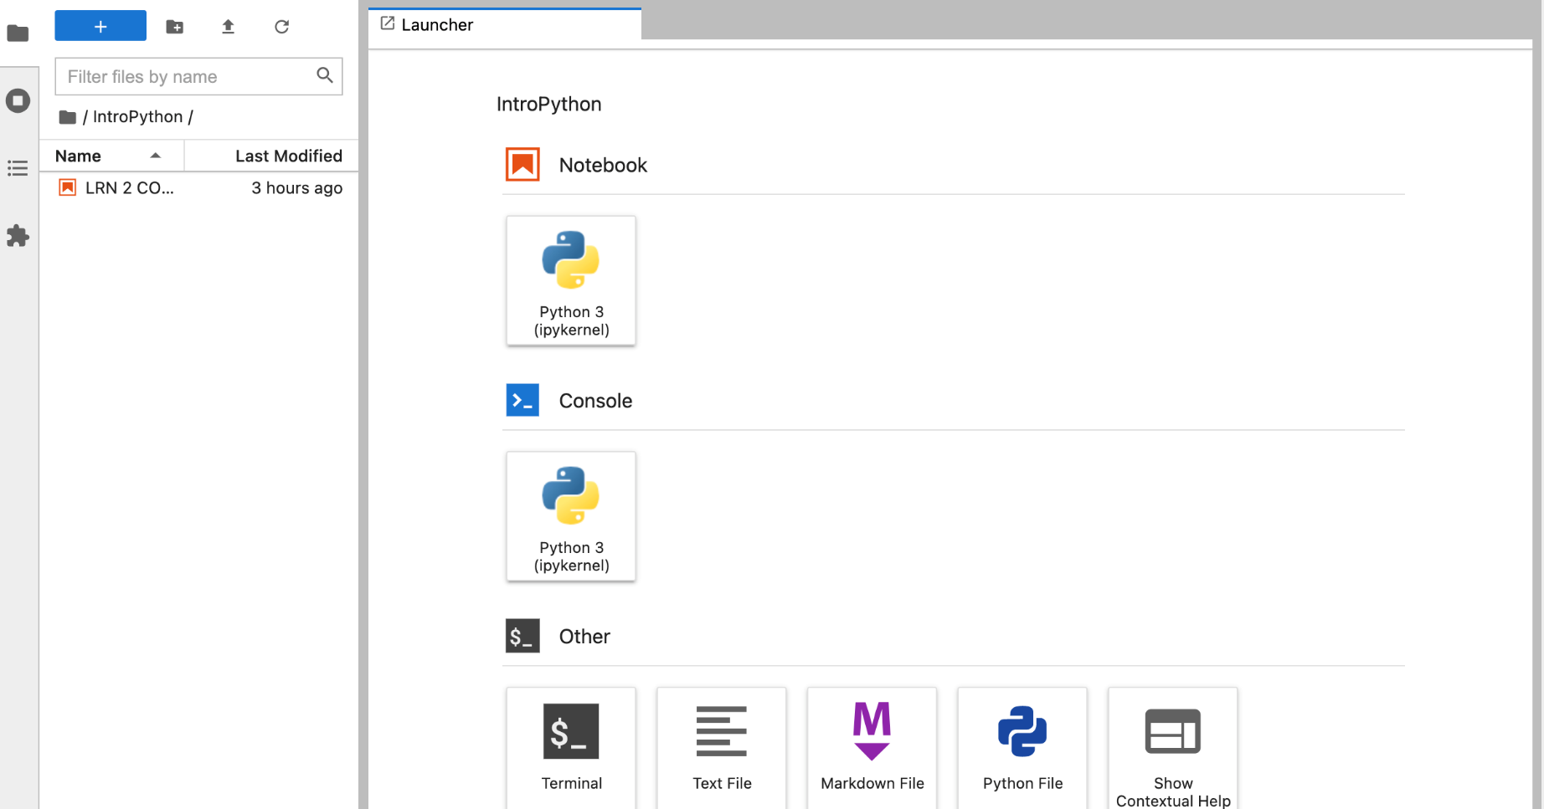
Getting started
Click the IntroPython folder
Click on LRN_@_CODE_2 to open the jupyter notebook file for today

Slide 5
Summary
Quick types/variables summary from last lesson
Notes:
Going to quickly refresh your memories on some of the things we touched on last time that we’ll actually start using this time.

Slide 6
Types cheatsheet
Name | Type | Description
Integer | int | Whole numbers, such as: 3 300 200
Floating point | float | Numbers with a decimal point: 2.3 41.6 507.912
String | str | Ordered sequence of characters: ‘hello world’ ‘Jack123’ “200” “馬 / 马”
List | list | Ordered sequence of separate objects: [15, “dog”, “200”]
Dictionary | dict | Unordered key:value pairs: {“key here” : “value here”, “name” : “Emily”, “workplace”: “Allen Institute”
Set | set | Unordered collection of unique objects: {‘a’, ‘b’, ‘c’}
Boolean | bool | Logical value indicating True or False

Slide 7
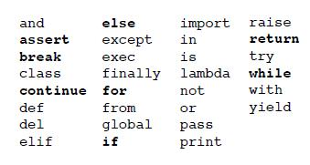
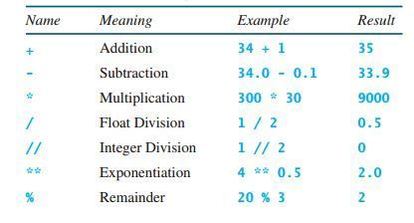
Keywords and Operators
Sometimes, you want to leave a note to yourself (or others) in your code. This is called a comment. Do it more often than you think is necessary! You will definitely *not* remember what you were thinking by tomorrow!
The comment “operator”, or special character that implies mathematical or logical operations, is # - Anything following the # will be ignored by your code (operators work like the “keywords” we mentioned earlier).
For reference, Here’s a short list of keywords (left) and operators (right) so you know what to avoid:
Notes:
Is there anything else anyone needs us to go over before we test your skills?

Slide 8
On to some Practice!
Write a script that solves and prints the result of 23 * 71
Write a script that checks if the answer to the previous script is greater than 200
Notes:
Show us what you got! Go to your notebooks and try solving these problems. You’ll have the answer sheet available, but don’t use it unless you really feel stuck and neither Emily nor I can help you. Notice that your answer was a boolean!

Slide 9


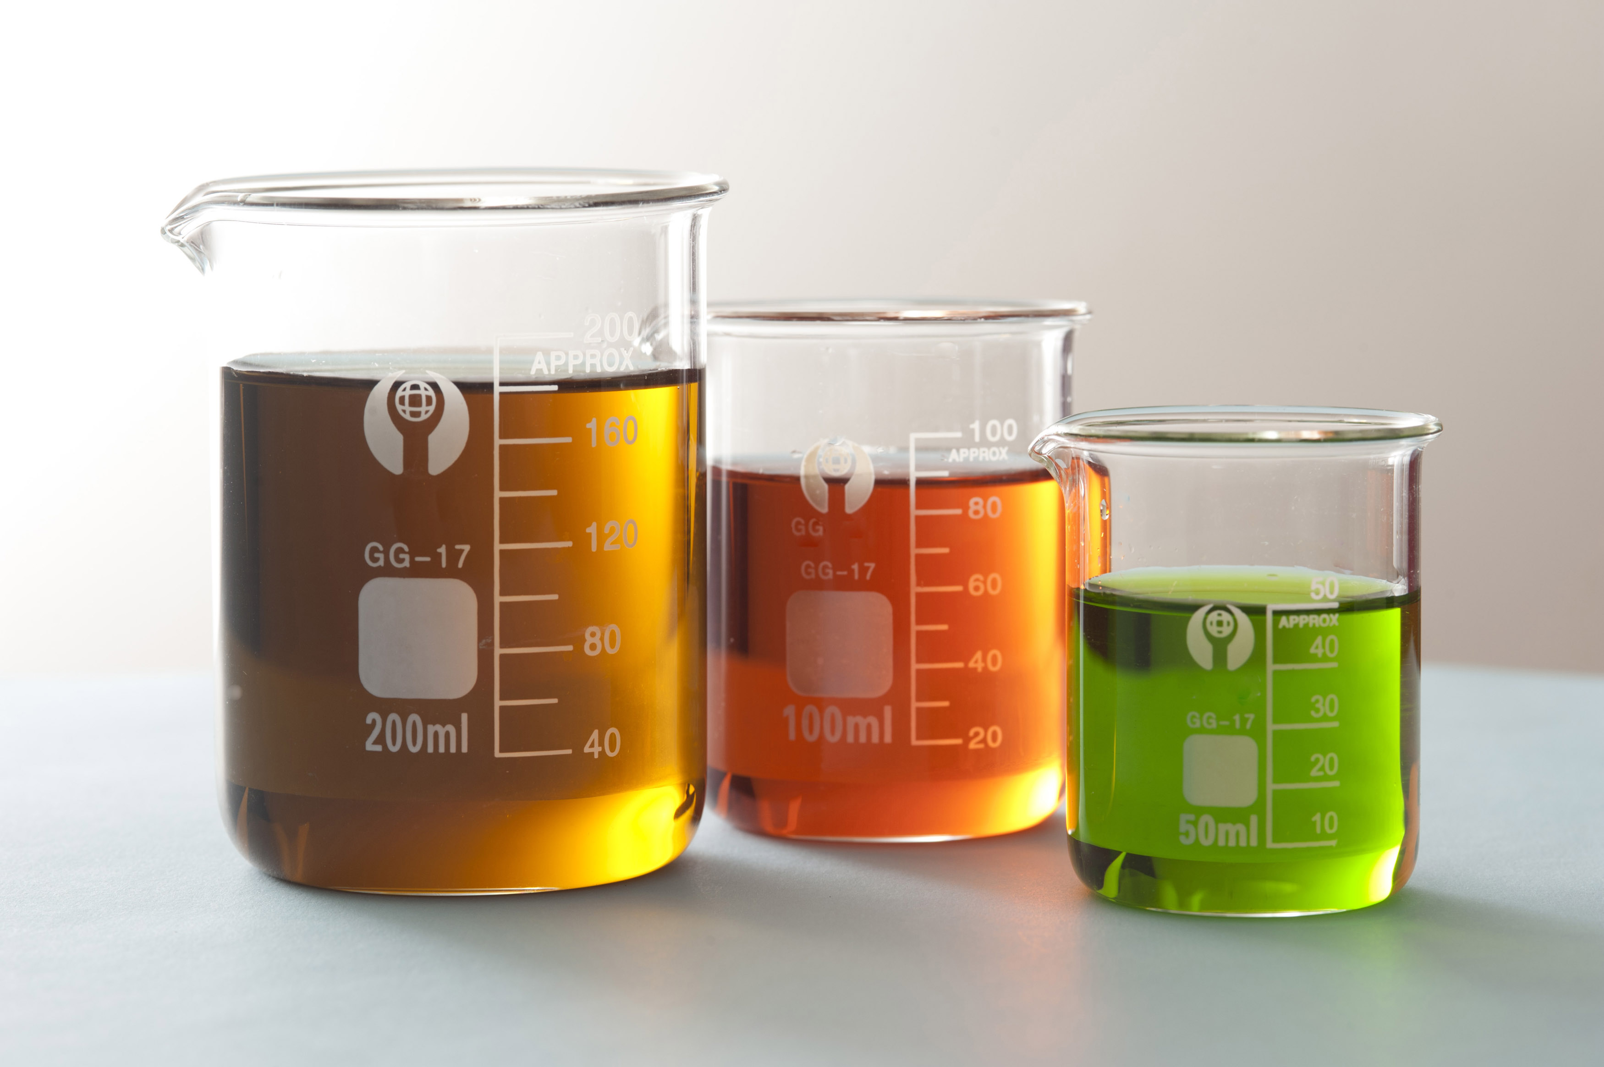
STORY TIME!
Last week your lab ran the same experiment twice on different days, all using (what they thought) were samples from the same batch. Each experiment should have generated 5 good pieces of data.
However, when the results came in, your team realized that both experiments turned out totally differently! Some of the resulting data was junk, and other parts were perfectly fine, and no one is sure of precisely what was different.
You’ve been asked to investigate the experiment data for a potential cause for your upcoming data review meeting – can you find the answer?
First, let’s find out what tools we can use to solve this mystery!
Notes:
This is a real problem I’ve solved just recently for our lab, but I felt like it was generalizable enough that I’ve experienced it in just about every other lab I’ve worked at or with. So, here’s the story: …
As you can see, there’s lots of things that could be the cause here, or could potentially be irrelevant. What does the prompt suggest might be the problem before you even see the data, knowing nothing about the experiment? Rather than doing what people without skills to manipulate data can do, let’s learn how we can find the answer.

Slide 10

Doing more with strings
Replace, join, find, split
Notes:
Moving on to some more complex work: Doing more with strings! Working with strings is a common tool, and python has a lot of built in support. We won’t get to spend too much time diving into this, but I’ll give some examples that you can play with later. Try to follow along in your notebooks for these as I’ll include a little test of knowledge for you at the end of each explanation. As always, remember, we love and want your questions, please ask them!

Slide 11
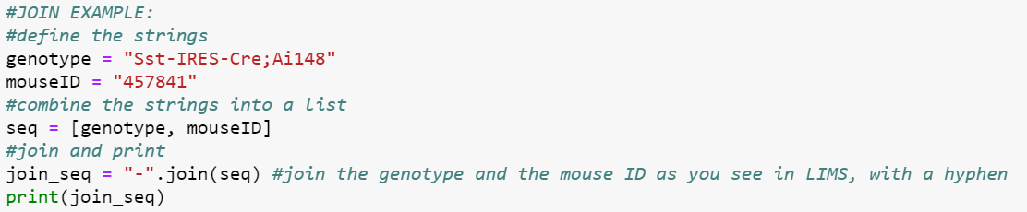
JOIN
We joined some strings together using + when learning about variables earlier, but there’s another way to do so which is especially useful if you want to join multiple strings together into a single string without typing the + “ “ + sequence every time. The method is called with the structure:
join(string_sequence)
Or
join_character.join(string_sequence)
Example:
Notes:
Try adding a third piece of information in between the genotype and the animal ID, like the word “mouse”. Try joining the genotype and the animal id with another delineator, like a question mark.

Slide 12
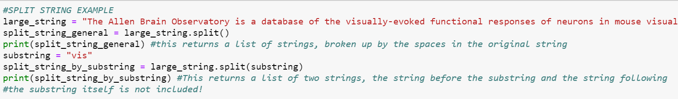
Split
If you want to split a string instead of joining it, python has a method for doing that as well, like so:
string_to_split.split()
You can specify how you want to split the string by adding a delineator as a parameter to the method, like so:
string_to_split.split(“a”)
Example:
Notes:
TASK: Try splitting this string by the symbol “.”. What happens? What about “?”

Slide 13
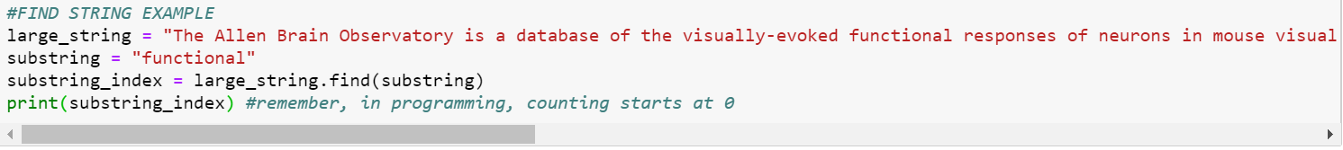
Find
Sometimes you have a long string and want to know when the part you care about starts. To find out if a string contains another string, and if so, where, use find:
larger_string.find(“substring”)
Example:
Notes:
Task: Find where the word temporal starts. How about the word rainbow?

Slide 14
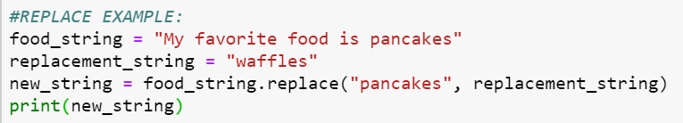
Replace
Replacing a string in python is fairly simple, and doesn’t require finding it first – the structure of the method you’d call is
string_name.replace(old_string, new_string)
This automatically replaces the old string with the new string every time the old string appears. If your sentence has multiples of the same old string in it, you can define how many of those old strings you want replaced (in order), like so:
string_name.replace(old_string, new_string, 4)
Here’s an example:
Notes:
Task: replace the favorite food here with your own favorite food! Any questions before we move on to another practice?

Slide 15
PRACTICE # 2
In the “Practice #2” cell in the jupyter notebook you got, you’ll see a string containing some messy animal data.
Find where the second animal ID starts.
Split the string into two strings, one for each animal's data (each string should contain one animal ID, one project name, one genotype, and one barcode)
Replace the project name with the phrase “Mindscope“, and then Join the two strings back together, separated by a hyphen.
Notes:
Split, find, replace, join. Ask us any questions you might have – this one’s harder than the last! We’re here to help!!

Slide 16

Control flow
Now that we’re getting stronger, let’s talk more complex logic!

Slide 17
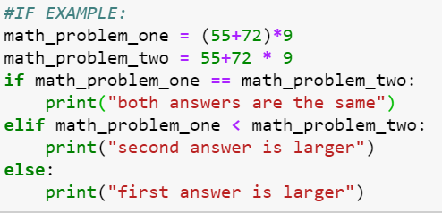
If statements
Let’s say you want your code to make a choice, depending on the result of a calculation. This is called a “conditional” statement, where code is executed based on a condition. Operators can be used here, such as >, <, or == as well as keywords OR or AND.
The key phrases to use here are if followed by else. Optionally, if there’s more than one condition, you can also use the keyword elif in between, which allows you to add conditional statements.
Example:
Notes:
Why two equals signs? If you’ve noticed, we’ve used one equals sign to indicate that we’re setting a variable equal to something. Two equals signs is a test for equality, rather than an assignment of a value.
TASK: change the operations in the math problems to get the first result to print. Now can you make it print the second?

Slide 18
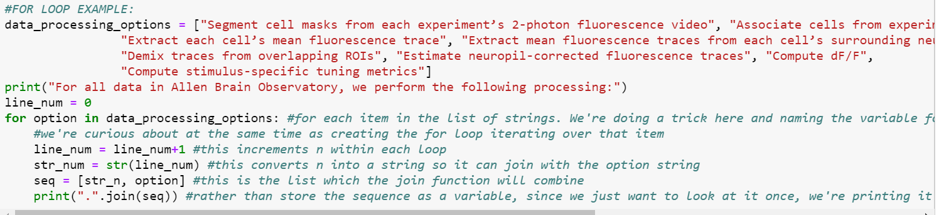
For Loops
Sometimes you’ll need your code to do the same thing multiple times, and store the results. For this, we use a for loop, which will repeat the contained code block until the defined stop condition is met.
Example:
Notes:
TASK: remove the second and fourth items in the list and reprint the for loop – does the numbering change? Now add a silly item somewhere in the list and print the for loop again.

Slide 19
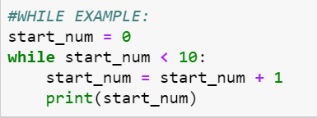
While Loops
Sometimes you need your code to keep running for a long time until a certain condition (called a “stop” condition) is met. Unlike for loops, the number of times a while loop will run is not set ahead of time, and sometimes not always known! A common error mode when using while loops is not setting a valid stop condition, which leads to it running forever, and eventually crashing once its used up all of your computer memory. Remember to always check what you’re running, and to check your stop conditions!
Example:
Notes:
TASK: What happens if we remove the line that adds 1 to the start num? This is where we learn about the “stop” button!
Change the operation on the start num so it prints only odd numbers. Any other questions before our final practice?

Slide 20
PRACTICE 3
Now we’re ready to rock our upcoming meeting and solve the mystery of the two “identical” experiments with different results!
In your notebooks, under practice 3, you’ll find information from both experiments. Search the data for clues using the tools we just learned how to use, and find the culprit!
There are many valid ways you can solve this problem. If you get stuck, feel free to ask questions in the chat!

Slide 21

Wow, that was a lot!
No worries – all of this information takes time and practice to master. Even if the concepts themselves seem simple, there’s a lot to remember and keep track of.
Just keep practicing and you’ll DEFINITELY improve!

Slide 22
Thanks for coming!
Questions? Concerns? Suggestions? Need info?
!RADS_ORG
Python documentation: https://docs.python.org/3/
Contains a handy tutorial and links to documentation for previous versions of python.

Slide 23
THANK YOU
We wish to thank the Allen Institute for Brain Science founder,
Paul G. Allen, for his vision, encouragement and support.

